Slide 1




County Roadshows
Hazel Grove Golf Club
Thursday 3rd April 2025

Slide 2


County Roadshow 2025
PROGRAMME
Unification
About Us
England Golf updates
Affiliation fee breakdown
Rules of Golf
WHS
Course Rating
Sustainability
Questions and Answers

Slide 3
County Roadshow 2025
Cheshire Golf Limited (CGL)
The result of the unification of the Cheshire Union of Golf Clubs and the Cheshire County Ladies Golf Association on 23rd September 2024, is that Cheshire Golf Limited now represents a single voice for golf within Cheshire.

Slide 4
County Roadshow 2025
Cheshire Golf Limited (CGL)
President and Directors
President: John Heggarty
Deputy President: Marjorie Griffiths
Chair: Cleveland McCurdy
County Secretary: Steve Doughty
England Golf and Northern Counties: Christina Hornsby
Golf Development: James Salt
Player Development: Josh Sims
Finance: Dave Kimpton
Championships and Competitions: Stewart Neil
Communications: Tracy McGregor
Clubs: Jean Payne

Slide 5
County Roadshow 2025
Mission Statement
Our mission is:
• “to encourage our affiliated members to promote and grow the game of golf in Cheshire in a safe and friendly environment, welcoming everyone, irrespective of age, gender or ethnicity.”
• “to represent and support the clubs in introducing and providing a broad range of competitive golf for their members whatever their level of ability.”

Slide 6


County Roadshow 2025
Ben Johnson
Club & County Support Officer (CCSO)
Email
ben.johnson@englandgolf.org
Telephone
07702 555564

Slide 7


County Roadshow 2025

Slide 8

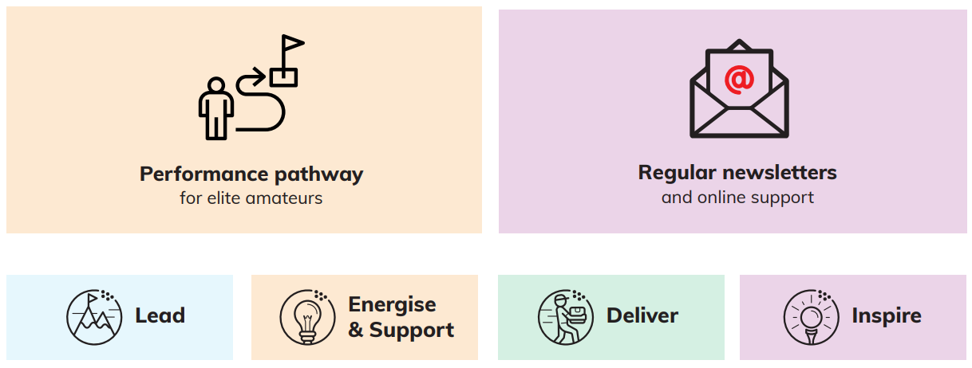
County Roadshow 2025

Slide 9
County Roadshow 2025
Mandatory Term of Affiliation by December 2024
100% of clubs across Cheshire signed off
3 clubs completed EDI audit
Continue to promote positive action

Slide 10
County Roadshow 2025
Has your club opened up course access to women at the weekend, having previously either had a rule which entitled men to a portion of access but not women, or have you removed weekly men’s competitions that took up tee times on a Saturday/Sunday morning meaning that women couldn’t play?
Has your club moved to a single Club Captain (no section captains), or have you tried to do this and had it rejected by the membership?
Notes:
Question 1 - Need the example(s) to be where they have decided to make the switch, not an example where women have always had full access.
Question 2 – Has this change been made in a bid to be more progressive, open to men and women, and their selection process etc.

Slide 11


County Roadshow 2025
Girls Golf Rocks (GGR)
Get into Golf: Rookies

Slide 12

County Roadshow 2025
National junior golf campaign
Open to boys and girls
Delivery Window
7th April – 2nd November 2025
Application Deadline
31st August 2025

Slide 13

County Roadshow 2025
Official WHS™ Handicap for non-club members
Nationwide iGolfers: 55,000
Cheshire iGolfers: 1880
iGolf subscribers into membership: 604
FREE marketing & revenue growth opportunity

Slide 14
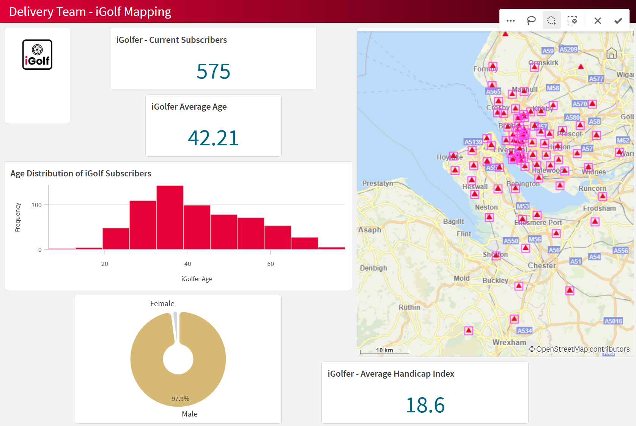
County Roadshow 2025

Slide 15

County Roadshow 2025
FREE access to entry and exit surveys
1-year FREE membership satisfaction survey access
Reduced rate for 2nd year
Full comprehensive dashboard
AI Assistant

Slide 16

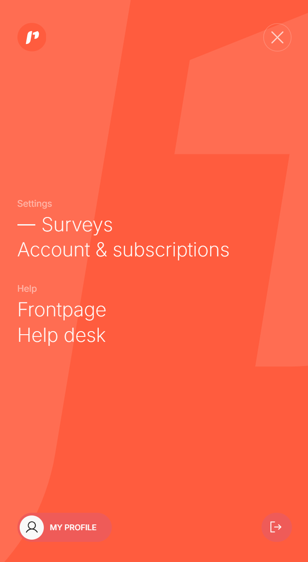
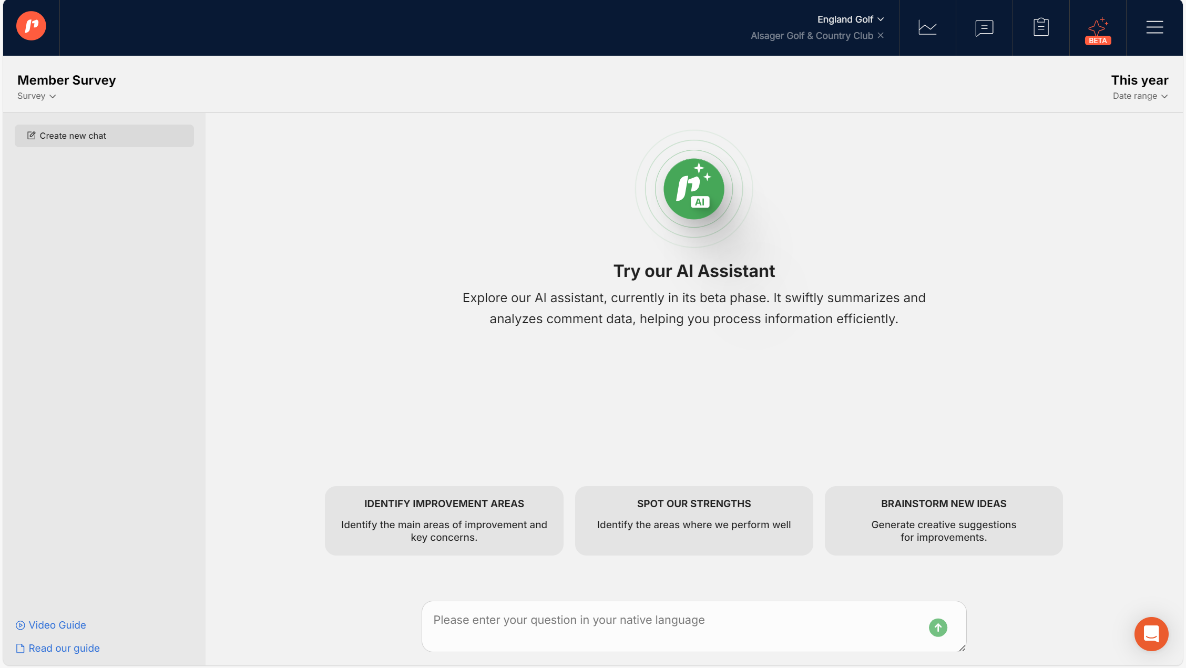
County Roadshow 2025

Slide 17
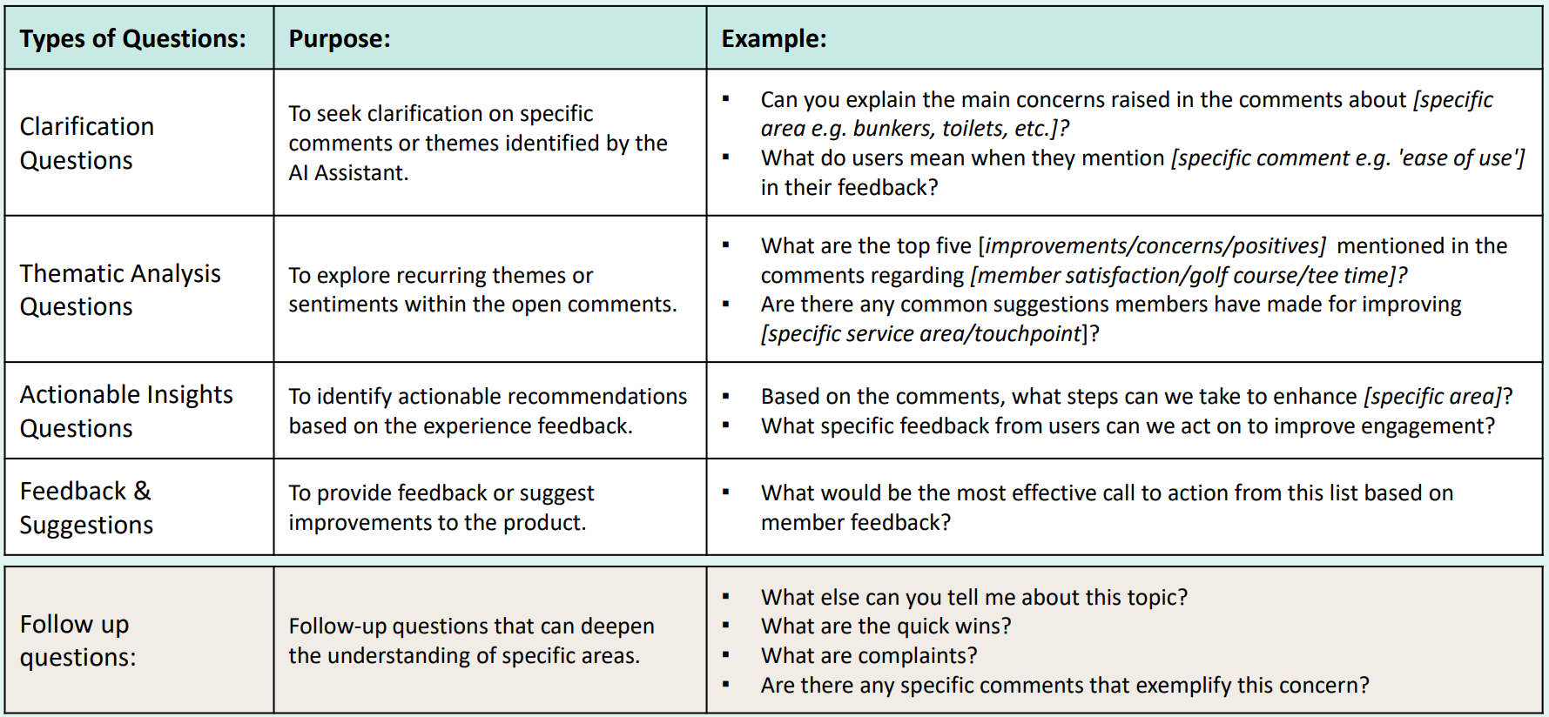
County Roadshow 2025

Slide 18
County Roadshow 2025
What you get for your affiliation fees?
Cheshire Golf
We run tournaments for the elite golfers and any golfer with a WHS handicap index.
We organise teams at Men’s, Senior Men, Boys Under 18, 16 and 14 level, Women’s, Senior Women and Girls to compete in inter-county and national events.
We provide a first-class coaching structure for all our squads.
We offer coaching to young players from aged ten and upwards via our Golf Development Coaching.
We fund projects to attract to new golfers to the game, via our Golf Development Programme.

Slide 19
County Roadshow 2025
What you get for your affiliation fees?
Cheshire Golf - continued
They enable us to interact with our Clubs via our County Roadshows and offer advice on items such as the Rules of Golf; WHS; Course Rating; Sustainability and Disciplinary issues.
Maintain up-to-date safeguarding requirements for our Cheshire volunteers involved in junior golf.
They provide the funding for Course Rating.
They support golfers with disabilities to participate in coaching. (In 2025 we will continue to work with the Cheshire East Branch of the Stroke Association).

Slide 20
County Roadshow 2025
What you get for your affiliation fees?
Cheshire Golf - continued
It promotes the sharing of knowledge between Clubs through the County Office.
It employs a County Secretary who runs the county on a day- to-day basis and builds relationships with Club managers and secretaries and other club officials.
The County Card scheme – which is free to all affiliated Cheshire members.
The chance to join our Life Members Scheme for a fee of £25 and to enter one or more of our seven Life Members Days during season.

Slide 21
County Roadshow 2025
Rules of Golf – What Cheshire can offer?
There are 18 rules officials / referees currently on the rota within the county.
All are at least level-2 qualified, with four of us being level-3 qualified.
Our prime role, as part of the tournament administration team, is to provide an on-course referee service at the county events which require referees.
As part of the preparation for a county event, we offer to conduct course reviews at the host club.

Slide 22
County Roadshow 2025
Rules of Golf – What Cheshire can offer – continued.
We will also conduct local rules reviews with any club. (Many of us do this with our home club by default).
Our new focus is offering “rules presentation evenings” for any county club.
  We will come to the club for a couple of hours and deliver a presentation covering the main rules that club golfers face on a regular basis, concluding with a level-1 type quiz.
  If the club wishes we can combine this with a local rules review and include key “watch-out” areas for your club within the presentation.

Slide 23
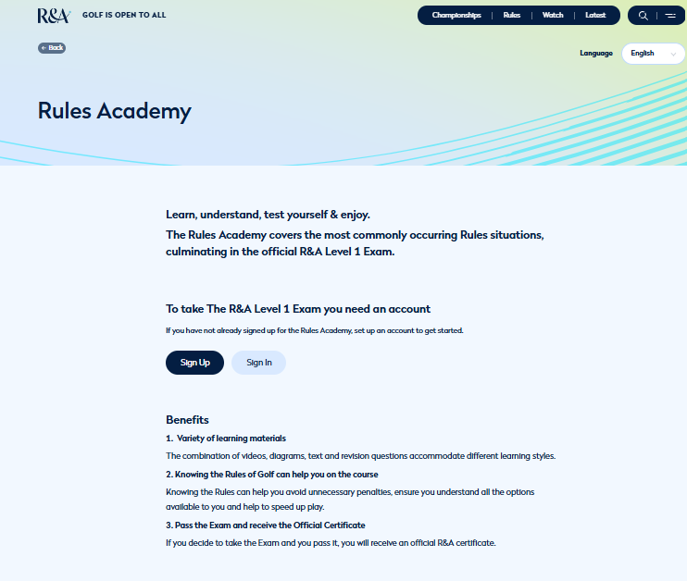
County Roadshow 2025
Rules of Golf – What Cheshire can offer – continued.
Finally:
Our challenge to all Cheshire Golfers..
Go onto the R&A website.
Sign up to the “rules academy”.
Do the level-1 examination.
It will clarify and give you more confidence to deal with most “regular rules situations” that arise in the monthly medal and club match-play KOs.

Slide 24
County Roadshow 2025
WORLD HANDICAPPING SYSTEM (WHS™)
Changes as of 1st April 2024
Course Rating vs Par – your Course Handicap will be affected by the difference between the Course Rating (CR) and the Par of the course:
  If the CR is higher than the Par, then you will receive additional strokes.
  If the CR is lower than the Par, then you will receive fewer strokes.
Example of Affect at a Club (Shrigley Hall GC):
  White Course: the CR is 71.6 and the par is 71. Members playing the white course will add 1 stroke to their Course Handicap*.
  Yellow Course: the CR is 70.2 and the par is 71. Members playing the yellow course will deduct one stroke from their Course Handicap*.
  Red Course (Men): the CR is 66.6 and the par is 72. Members playing the red (Men’s) course will deduct 5 strokes from their Course Handicap*.
  Red Course (Women’s): the CR is 71.6 and the par is 72. Members playing the red (Women’s) course will not have any adjustment to their Course Handicap*.
    * the adjustment will be rounded to full shots using the usual method of rounding in golf.

Slide 25
County Roadshow 2025
WORLD HANDICAPPING SYSTEM (WHS™)
Changes as of 1st April 2024
The Inclusion of Four Ball Better Ball Scores within GB&I:
  Stroke play competitions only (note: not social golf).
  Minimum of 42 pts. to activate calculation.
  Minimum of 9 holes completed for the player.
  Holes not completed will be assessed versus holes completed (computer software).
  Minimum of 36 pts. to activate WHS score inclusion.
Inclusion of Shorter-Length Golf Courses Within the Course Rating™ System:
  Qualification for a Course Rating and Slope Rating will be significantly reduced:
  18 hole course may be as short as 1,500 yards.
  9 hole course may be as short as 750 yards.

Slide 26
County Roadshow 2025
WORLD HANDICAPPING SYSTEM (WHS™)
Advice on adverse/extreme weather conditions
New guidance on adverse/ extreme weather conditions has replaced winter checklist.
  Outside of 30 April – 30 September clubs no longer need consult County Advisor to request use of Preferred Lies if conditions warrant their use.
  Clubs must use the Model Local Rule appropriately and on areas of the course where it is required. They must also be removed as soon practicably possible.

Slide 27
County Roadshow 2025
WORLD HANDICAPPING SYSTEM (WHS™)
WHS Workshop– at Sandiway Golf Club on Thursday 10th April at 10.00am.
WHS Workshop – at Ringway Golf Club on Tuesday 29th April at 18.00pm.
Book via England Golf website
WHS™ Workshop Registration Form
Subjects covered will be:
Score and Handicap Index® manipulation.
Is WHS™ too complicated?
Responsibilities of a golfer, attester and handicap committee.
Course Rating™ .
Plus, lots more.

Slide 28
County Roadshow 2025
Course Rating – What Cheshire can offer?

Slide 29
County Roadshow 2025
SUSTAINABILITY
Need advice on energy?
Part of the England Golf Sustainability Toolkit
Zellar - is an all-in-one sustainability platform.
An easy-to-understand online application helping you understand your current impact across multiple areas including energy and water, before analysing data and building reduction plans.
Contact: Becky Connell. Her email is: becky@zellar.com

Slide 30
Save the Date – Cheshire County Dinner
Cheshire Golf invites you to a night with snooker legend, and special guest for the evening, John Parrott.
Venue: The Pavilion Suite, Chester Racecourse.
Date: Friday 10th October 2025.
Time: Dinner at 7.30pm.
Price: £65 (includes three course meal and entertainment).
Dress code: Black tie or lounge suits for men and equivalent for women.
Accommodation: On site at Chester Racecourse at the Holiday Inn Express. Room rate is £95 including breakfast and rooms can be reserved by calling 01244 327 900 and quoting Chester Golf Allocation. When booking your room by phone, please speak only to the hotel directly. The booking can also be made by emailing the hotel directly. Their email is: hotel@chester-races.com

Slide 31
County Roadshow 2025
Questions and Answers. Thank you very much listening.

